Slide 1
Choosing Suitable Machine Learning Algorithm
Well you can see that our dataset look quite messy and the entropy (Entropy is the measure of randomness and unpredictability in the dataset ) is high in this case (phases, Candidate Name, Current Phase, Technology , Trial Number , advantage count , etc ).
First we classifying data , short listing it through Decision Tree (DT) Algorithm then use Multiple Regression (ML) Algorithm to Predict the date/time of releasing COVID-19 Vaccine.
Classification (Give categorical solution yes or no , 0 or 1) >> Naïve Bayes , Logistic Regression ( these two use when we have less calculation ) , Decision Tress (when you have more of data attributes and you what to short) , Random Forest ( DT is a form of RF when you have a lot of data then we use Random Forest) >> Regression (Use when continuous value need to predict like ‘date’ , ’profit’ , etc).

Slide 2
(DT) Dataset Of Vaccine (High Entropy)
Phase == Phase 2 or 3 ?
True False After many steps
Advantages > Disadv. Advantages > Disadv. (Lower Entr.)
True False True False
Result (After many steps like (Zero Entropy)
that)

Slide 3
Result (after using DT algorithm shortlisted data)
Regression (Multiple or Linear)
Output (Final result)
(Date/time of Covid – 19
Vaccine)

Slide 4
Short Information about Decision Tree (DT)
-> Belongs to the family of supervised learning algorithm.
-> Goal is to create a training model that can used to predict the class or value of the target.
Important Terminology related to Decision Trees
Root Node: It represents the entire population or sample and this further gets divided into two or more homogeneous sets.
Splitting: It is a process of dividing a node into two or more sub-nodes.
Decision Node: When a sub-node splits into further sub-nodes, then it is called the decision node.
Leaf / Terminal Node: Nodes do not split is called Leaf or Terminal node.
Pruning: When we remove sub-nodes of a decision node, this process is called pruning. You can say the opposite process of splitting.
Branch / Sub-Tree: A subsection of the entire tree is called branch or sub-tree.
Parent and Child Node: A node, which is divided into sub-nodes is called a parent node of sub-nodes whereas sub-nodes are the child of a parent node.

Slide 5
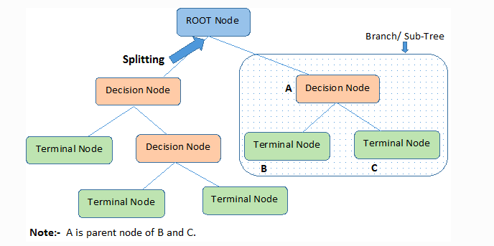

Slide 6
Assumptions while creating Decision Tree
(1) In the beginning, the whole training set is considered as the root.
(2) Feature values are preferred to be categorical. If the values are continuous the they are discretized prior to building the model.
(3) Records are distributed recursively on the basis of attribute values.
(4) Order to placing attributes as root or internal node of the tree is done by using some statistical approach.
Decision Trees follow Sum of Product (SOP) representation. For a class, every branch from the root of the tree to a leaf node having the same class is conjunction (product) of values, different branches ending in that class form a disjunction (sum).

Slide 7
Short Information about Multiple Regression (MR)
Multiple linear regression is a statistical method of predicting or explaining a continuous variable (sometimes called the dependent variable) as a linear combination of one or more variables (sometimes called independent variables).
The model is of the form
Y = ∑ b_{i} x_{i}+e
It makes several assumptions:
Independent errors (e)
Linearity - that is, that the model is linear in its parameters (the B)
Additivity of terms (although you can add interaction terms)
Errors have mean 0 and constant variance across all levels of x
normality of errors (necessary only for some aspects of how the model is used)

Slide 8
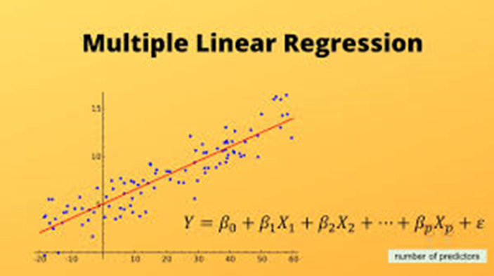

Slide 9
Assumptions in Multi Regression
Regression residuals must be normally distributed.
A linear relationship is assumed between the dependent variable and the independent variables.
Absence of multicollinearity is assumed in the model, meaning that the independent variables are not too highly correlated.
Why Multiple Regression –
This model is directly interpretable. It’s easy to get ideas from a regression model about how to change strategies.
Regression model is easily explainable.
Regression models are computationally cheap and extremely fast. Especially when you're running data through a model millions (or more) times a day, these differences in speed add up to real dollars and cents.

